Slide 1
Gridlock: Offensive Cyber Ops in OT Networks

Slide 2
Table of contents
01
02
03
04
Evolution of OT trends
Constraints of OT Environment
Rising Attacks and Business Impact
Recon - What Matters
05
06
07
08
Demo -1
Offensive Entry Points
Demo – Offensive Attacks
Q & A

Slide 3
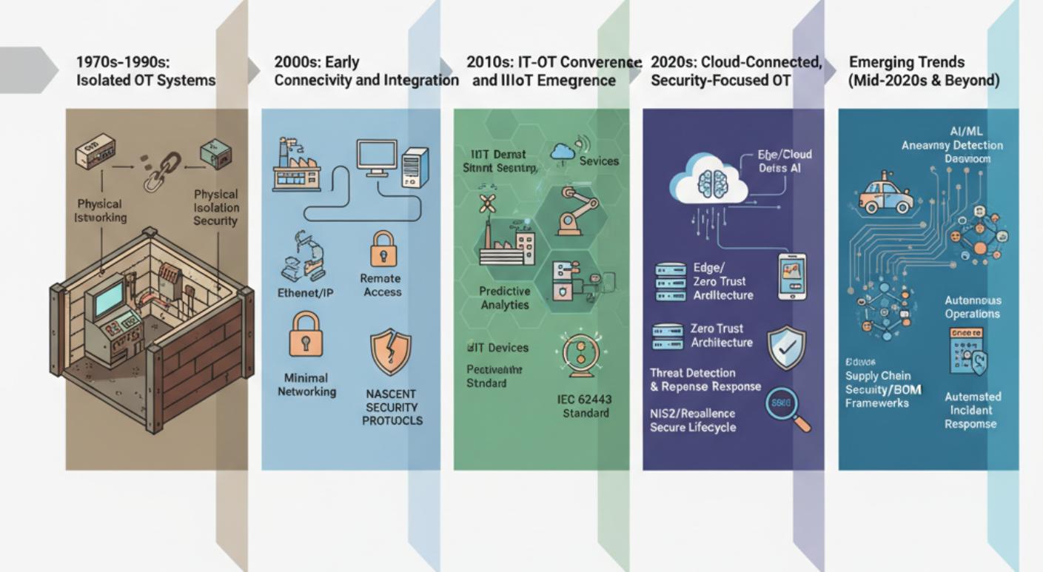
Evolution of OT trends

Slide 4
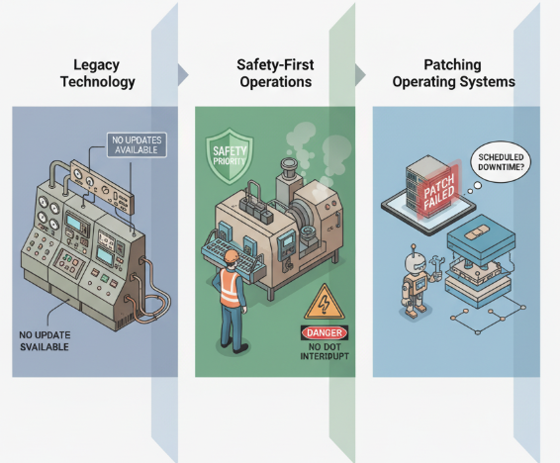
Constraints of OT Environment

Slide 5





Rising Attacks and Business Impact
The frequency of cyberattacks targeting OT systems has dramatically increased, with ransomware campaigns alone experiencing an 87% rise over the past year. [1]
Approximately 75% of OT breaches originate from compromised IT networks, exposing the fragile IT-OT convergence zone; attackers exploit weak segmentation and shared credentials to pivot into OT [2]
Business Impact of OT Incidents
Operational Disruption
Safety System Compromise
National Infrastructure Risk
Extended Recovery Times
Financial Costs

Slide 6
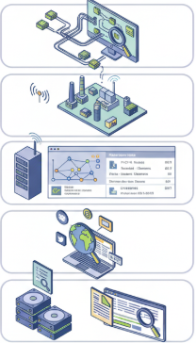
Recon - What Matters
Passive Techniques
Network Traffic Monitoring
Broadcast Protocol Listening
Asset Fingerprinting from Traffic Patterns
Open-Source Intelligence (OSINT)
Log and Backup File Analysis

Slide 7
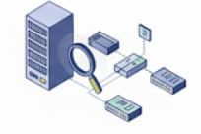

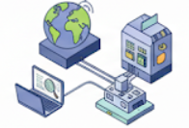


Recon - What Matters
Active Techniques
Protocol Querying and Scanning
Network Scanning
Engineering Workstation Interaction
Firmware and Configuration Probing
Service Enumeration & Banner Grabbing

Slide 8
Demo
Passive recon with Wireshark using an OT PCAP: ARP, DHCP, and LLDP reveal device IPs, MAC addresses, and network topology.
Active recon showcase with Modbus emulator: Read unit IDs and registers to identify PLCs and process variables.
OPC UA browse demo using open-source OPC UA client tool: Navigate browse tree, identify tags and data points.

Slide 9
Offensive Entry Points
Legacy and Unsupported Systems
Unauthenticated and Unencrypted Protocols
Flat Network Architectures / Poor Segmentation
Insecure Remote Access
Weak or Mismanaged Credentials
Firmware and Software Update Weaknesses
Inadequate Asset Visibility
IT/OT Convergence Security Gaps
Insider Threats and Human Error
Cloud Integration Misconfigurations

Slide 10
Demo
Modbus Write Demo
Unauthorized Modbus write to toggle coil or modify register causing unsafe equipment behavior.
PTP Drift Demo
Altering PTP messages skews relay trip timing using simulated network traffic.
Historian Exfiltration Demo
Simulated dump, tampering of historian data file from a virtual OT environment.
Attack PCAP Files
To identify from Wireshark captures, the attacks

Slide 11

Defensive Strategies
Network Segmentation and Micro-Segmentation
Asset Inventory and Continuous Monitoring
Secure Remote Access
Patch and Vulnerability Management
Strong Authentication and Access Control
Integrity Protection and Change Management
Incident Response and Recovery Planning
Security Awareness and Training
Supply Chain and Vendor Risk Management
Zero Trust and Cyber Resilience Approaches

Slide 12
Refrences
[1] Zer0Networks. (n.d.). OT security trends 2025: Escalating threats, evolving tactics. Retrieved from https://zeronetworks.com/blog/ot-security-trends-2025-escalating-threats-evolving-tactics
[2] McMillen, D. (2025, September 08). The operational technology threat landscape: Insights from IBM X-Force. IBM. Retrieved from https://www.ibm.com/think/x-force/the-operational-technology-threat-landscape-insights-from-x-force

Slide 13
Contact
Anupriya Pandey
Senior Security Analyst, Thales
(+91) 70235 39692
anupriya.anupriya@thalesgroup.com

